Slide 1

PRP43 基于深度学习的机器人加工 颤振在线辨识与智能抑振研究
阶段汇报（三）
2021级本科生 赵四维

Slide 2
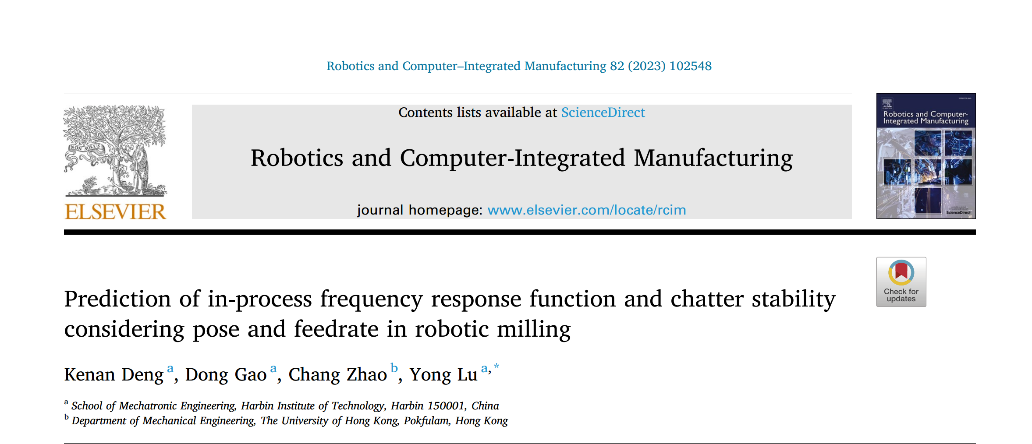
传统机器学习方法：GPR
Chapter 1

Slide 3
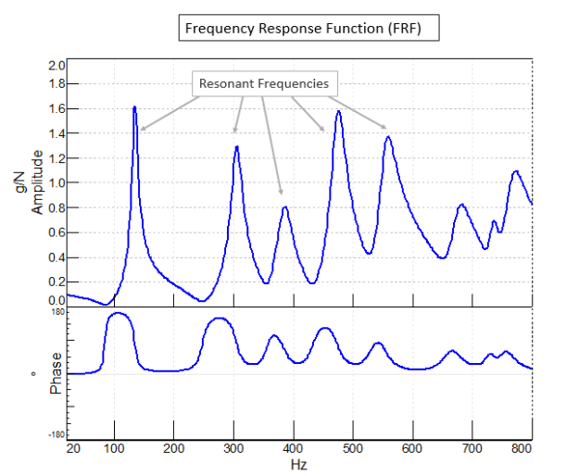
Backgrounds
Robotic static state
Using experimental model analysis (EMA) method
Dynamic properties
Affected by operating states and external load.
Frequency response functions (FRF)
It is challenging to obtain in-process FRFs
Notes:
649ad2db-8d3a-4973-ad22-0852ce57e02e.source.default.zh-Hans

Slide 4
Solutions
06
Predict the
stability lobe diagram (SLD)
05
Validation of the
proposed method
04
03
Data processing.
02
Reduce signal interference.
Predicting in-process FRFs
by combining
the FRFs predicted by the
Gaussian process regression(GPR)
and
the in-process modal parameters identified by
Operational modal analysis(OMA)
01
Train GPR model.
Static FRFs of a robot
obtained by EMA .
Notes:
57bb7dd7-5f46-44dd-ac5e-38e790017ba0.source.default.zh-Hans

Slide 5
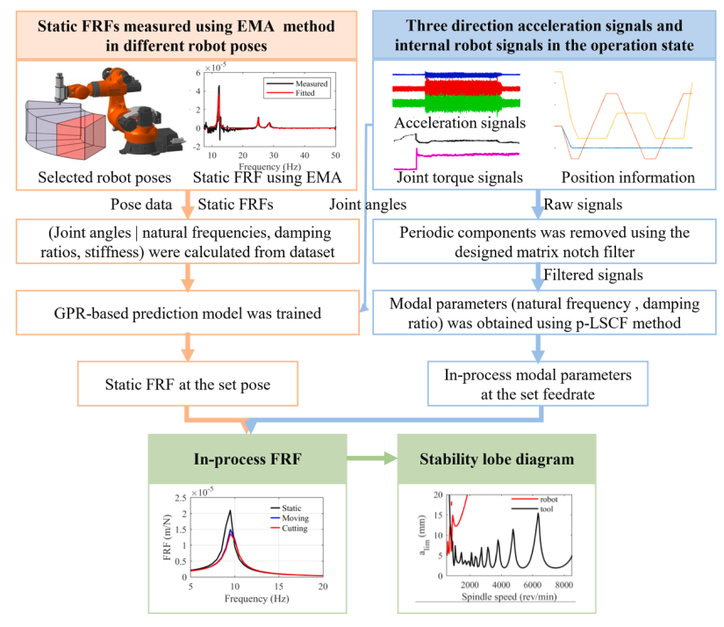
MISSIONS
To investigate the changes in robot dynamic properties
To perform chatter stability analysis
Identify the in-process FRF of the robot.
Confirmed that the SLD based on the in-process FRF

Slide 6
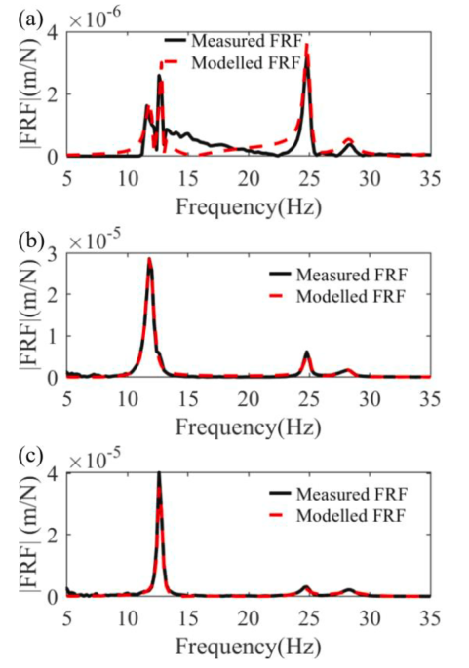
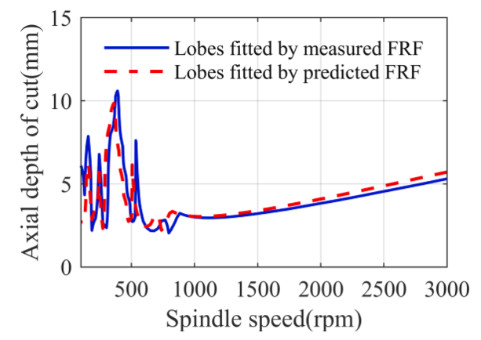
Model effect
Measured and modelled FRF of the robot in the (a) x–, (b) y–, and (c) z–directions
SLDs of predicted and measured FRFs of the robot mode

Slide 7
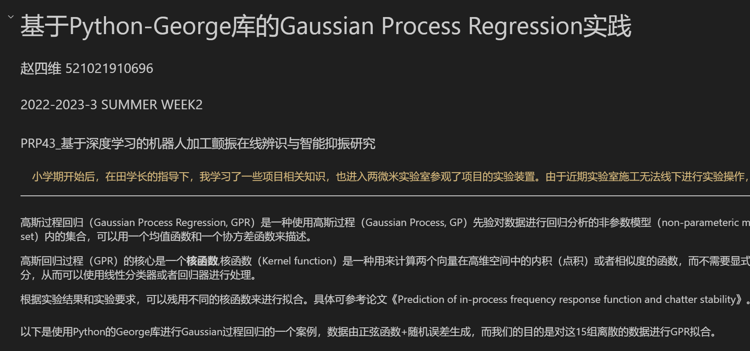
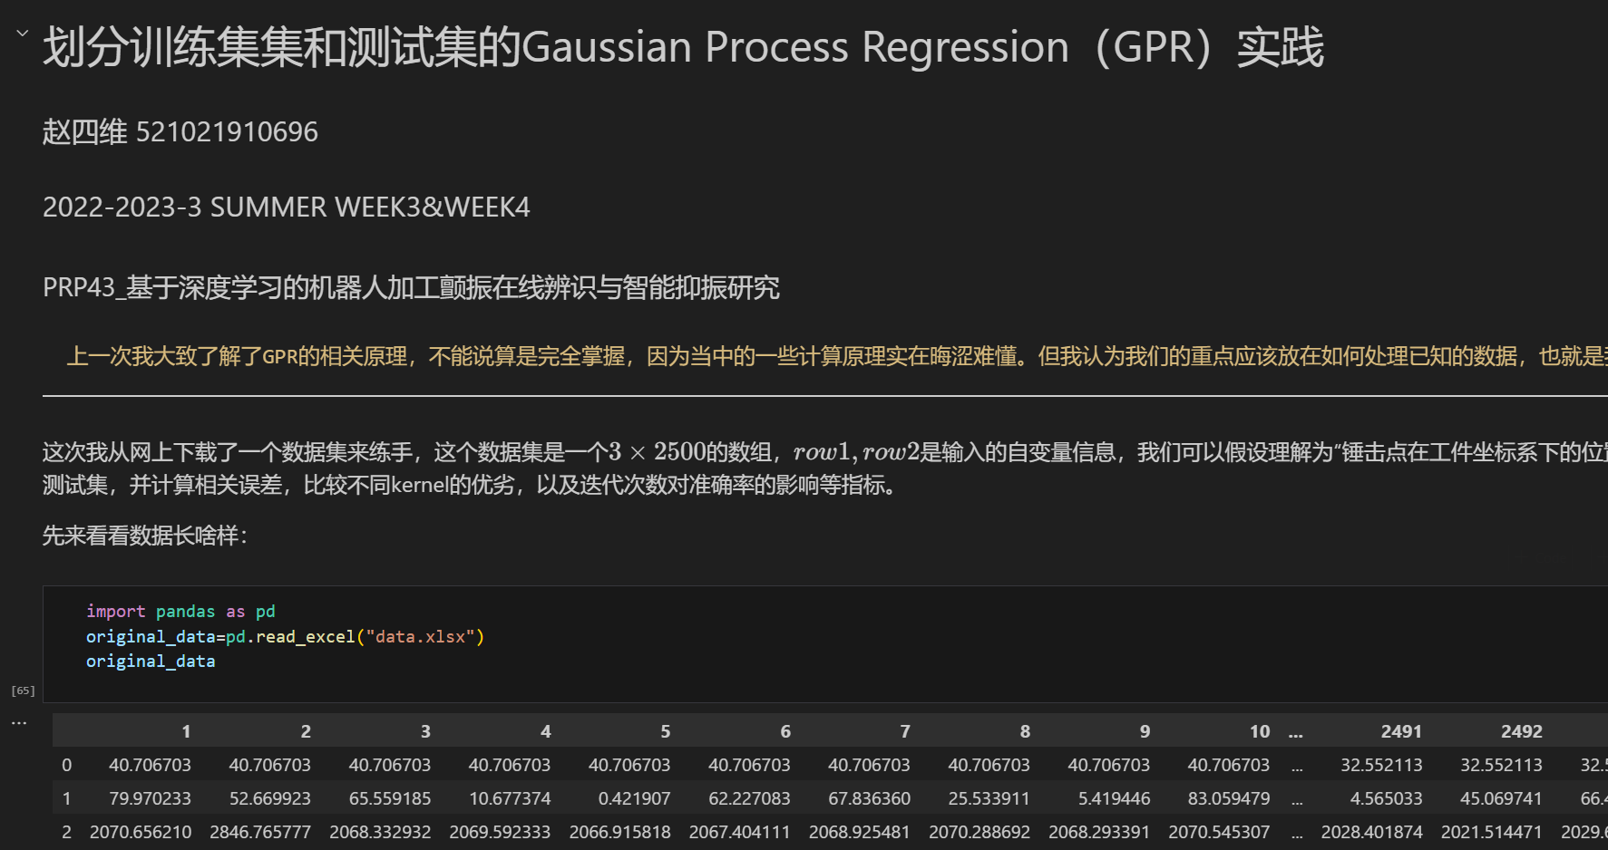

Slide 8
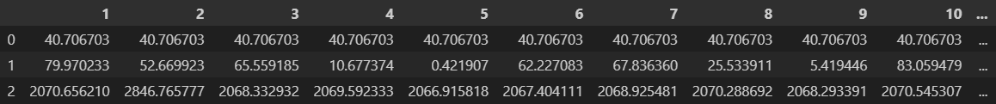
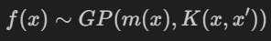
GPR practice
Data sets | Size
Random | (2500,3*1)
Inputs：The position of the hammering point in the workpiece coordinate system（x , y）
Outputs：Response , such as vibration intensity
Keys
Mean function
Covariance function
Dot Product
Radial basis function（RBF）
Kernel
Matérn kernel
Rational quadratic（RQ）

Slide 9
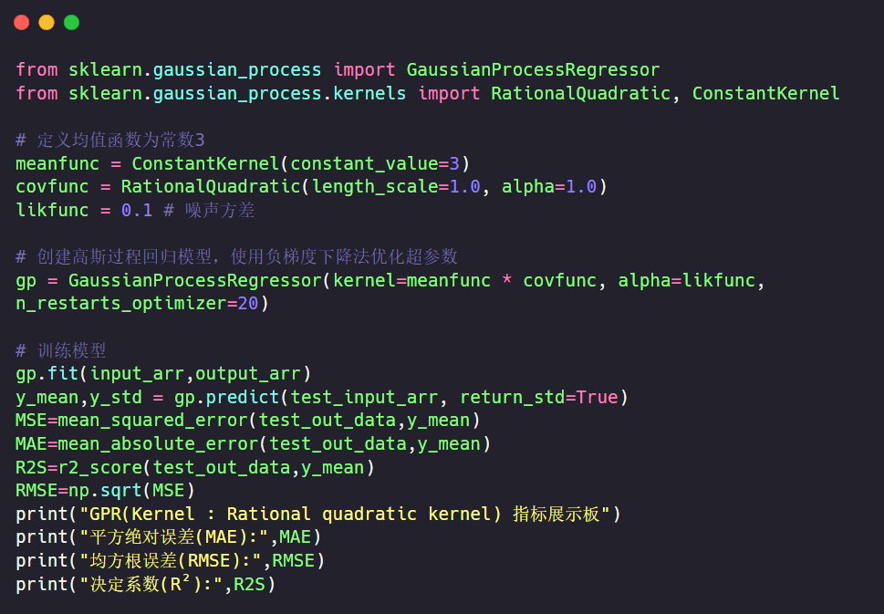
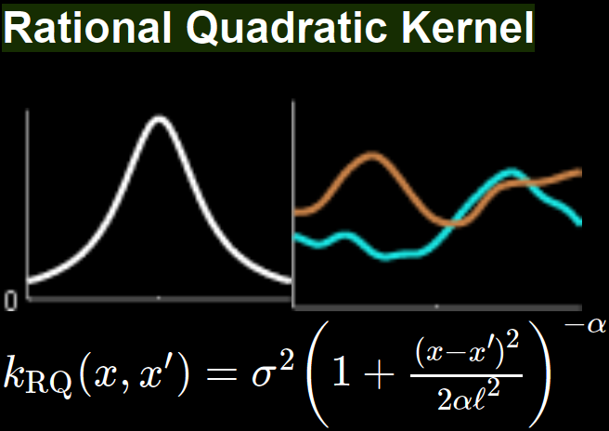
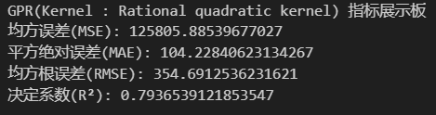
GPR practice（Python）
Notes:
27a6a2c5-9de4-4657-8419-502e16d36375.source.default.zh-Hans

Slide 10
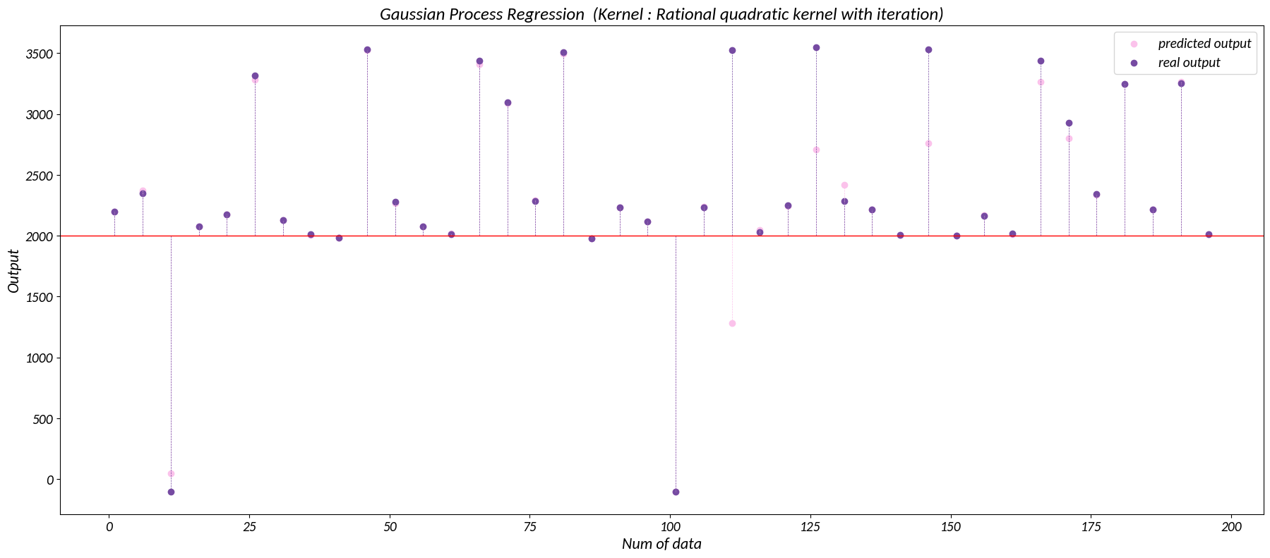
GPR practice（Python）
Predictions by RQ kernel display( Iter : 20 )

Slide 11

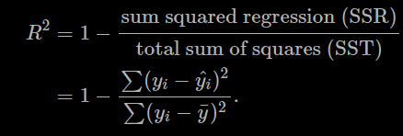

GPR practice（Python）
Kernel | MAE | R2 Score
Dot Product | 470.709 | 0.004
RBF | 250.198 | 0.543
Matérn | 250.198 | 0.543
RQ | 104.228 | 0.794
Mean absolute error(MAE) :
Coefficient of determination(R²) ：
Powered by

Slide 12
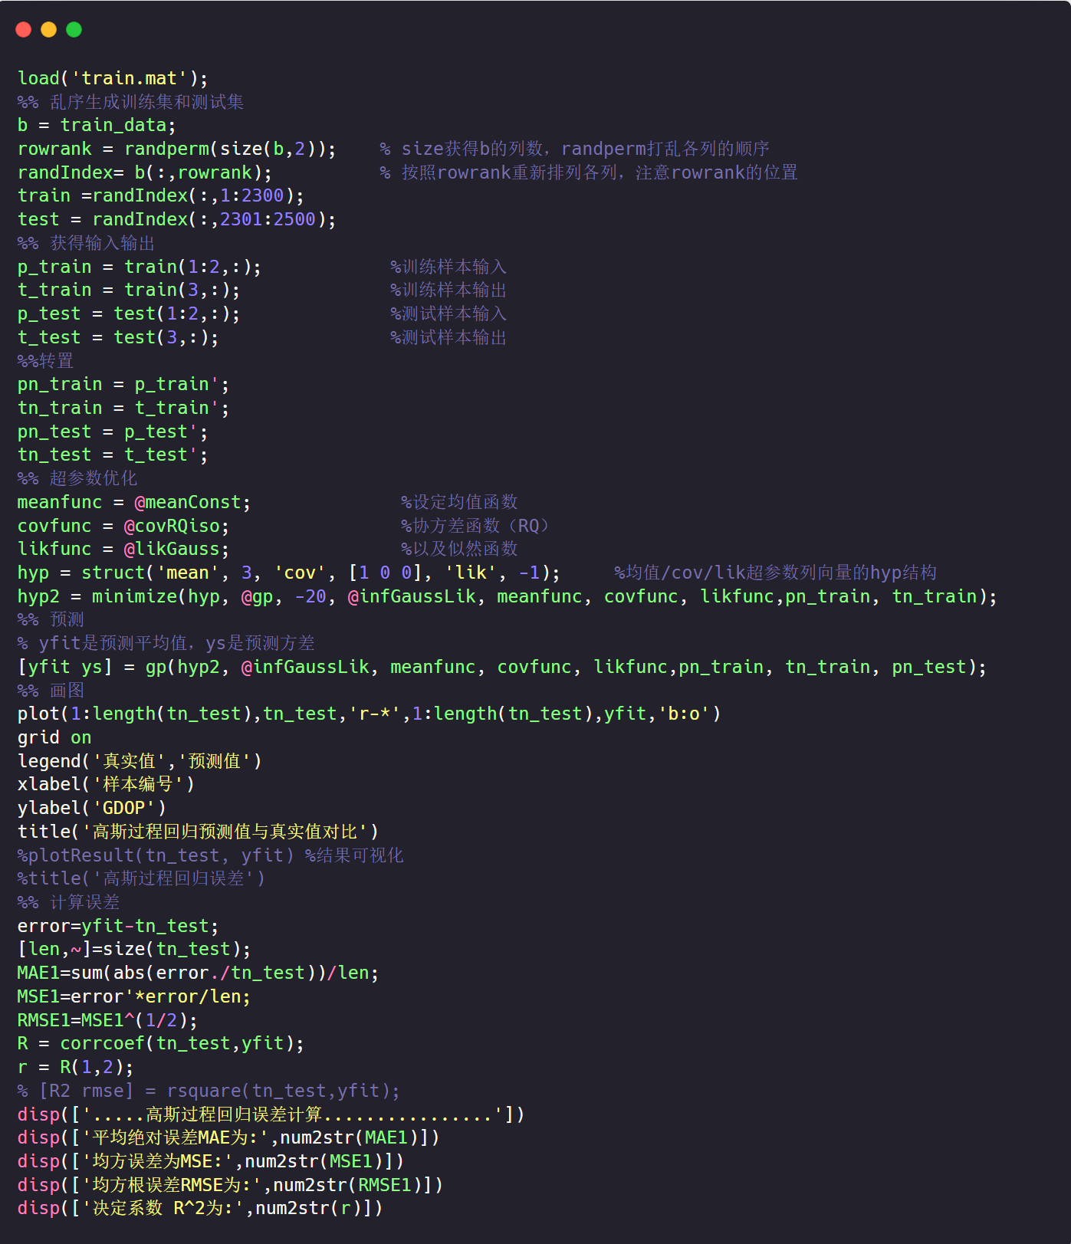
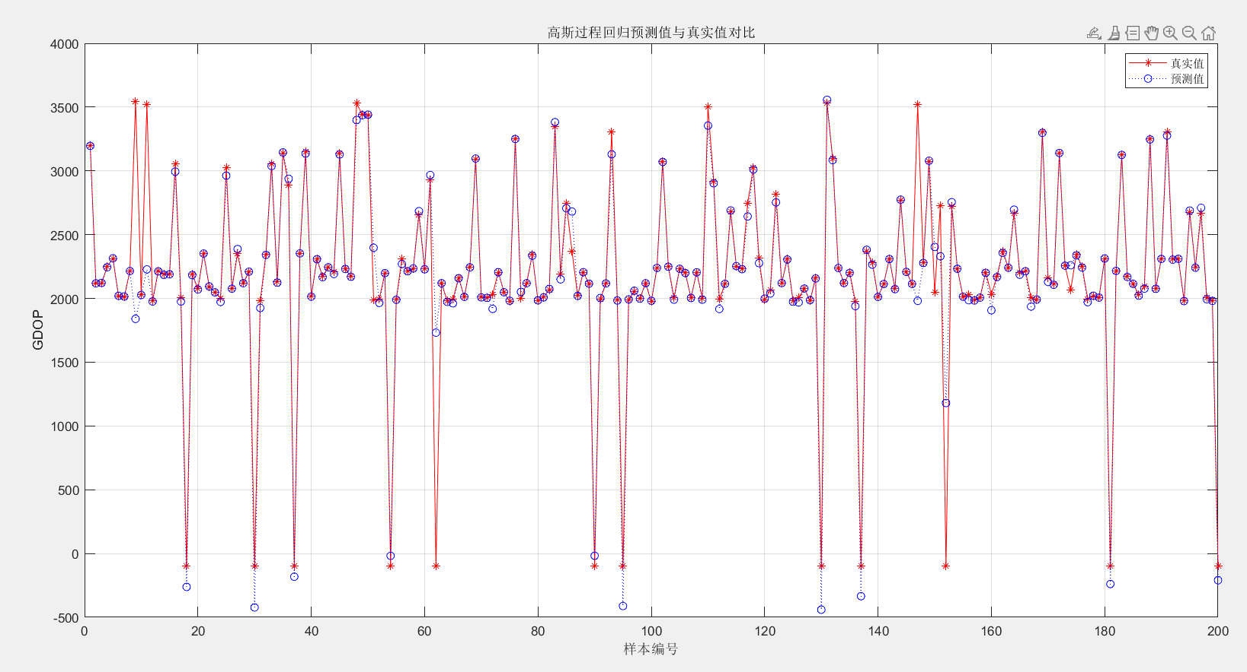
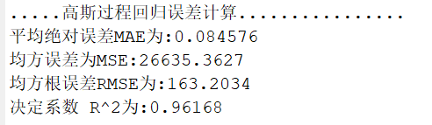
GPR practice（MATLAB）

Slide 13
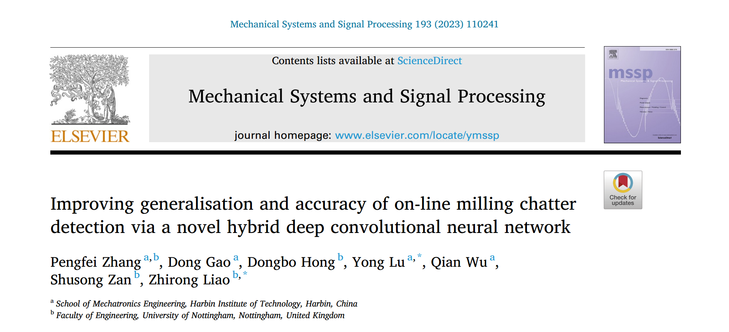
深度学习方法：CNN
Chapter 2

Slide 14
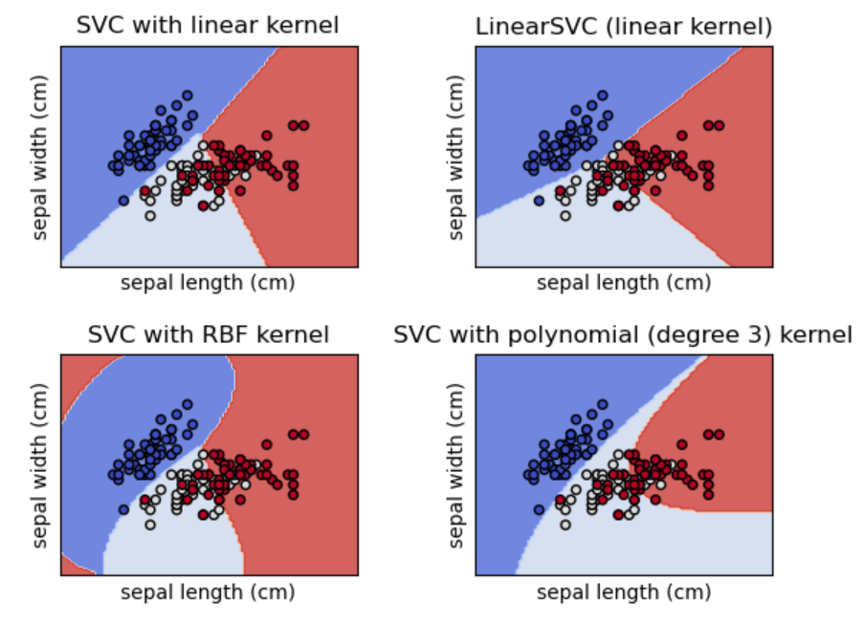
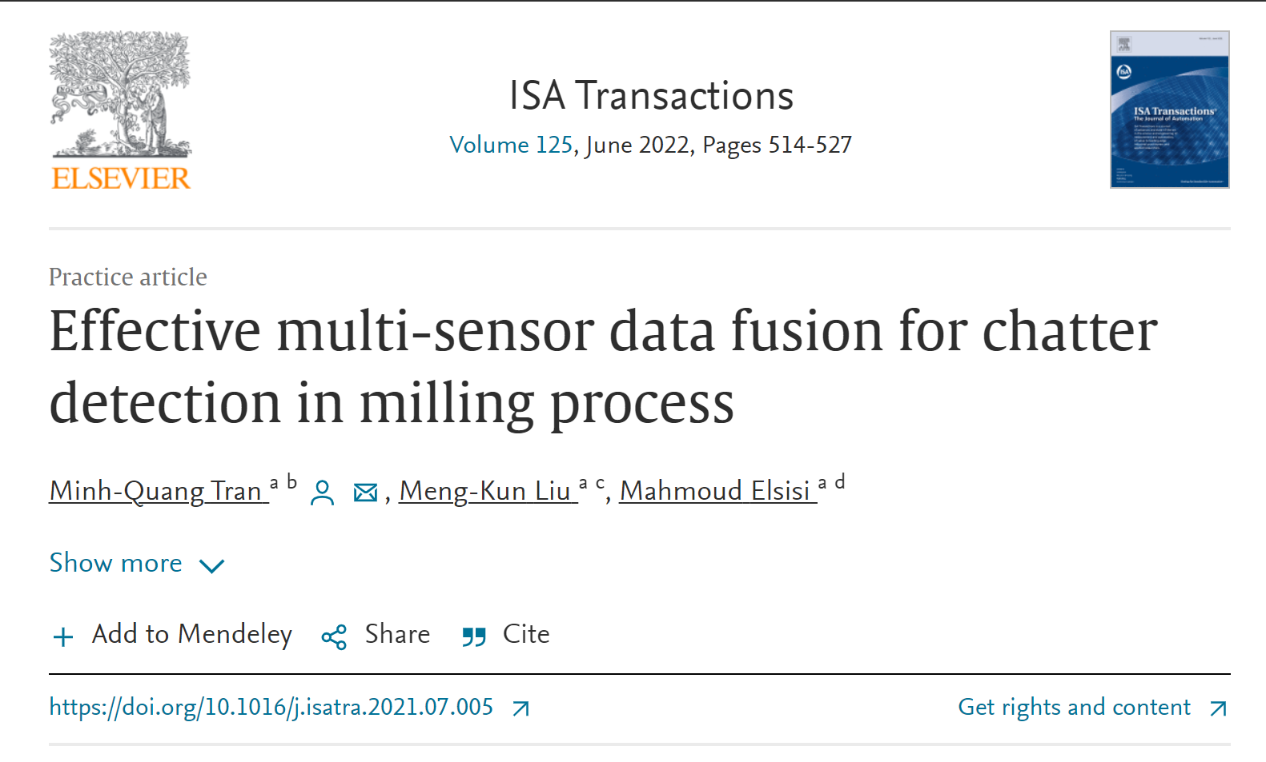
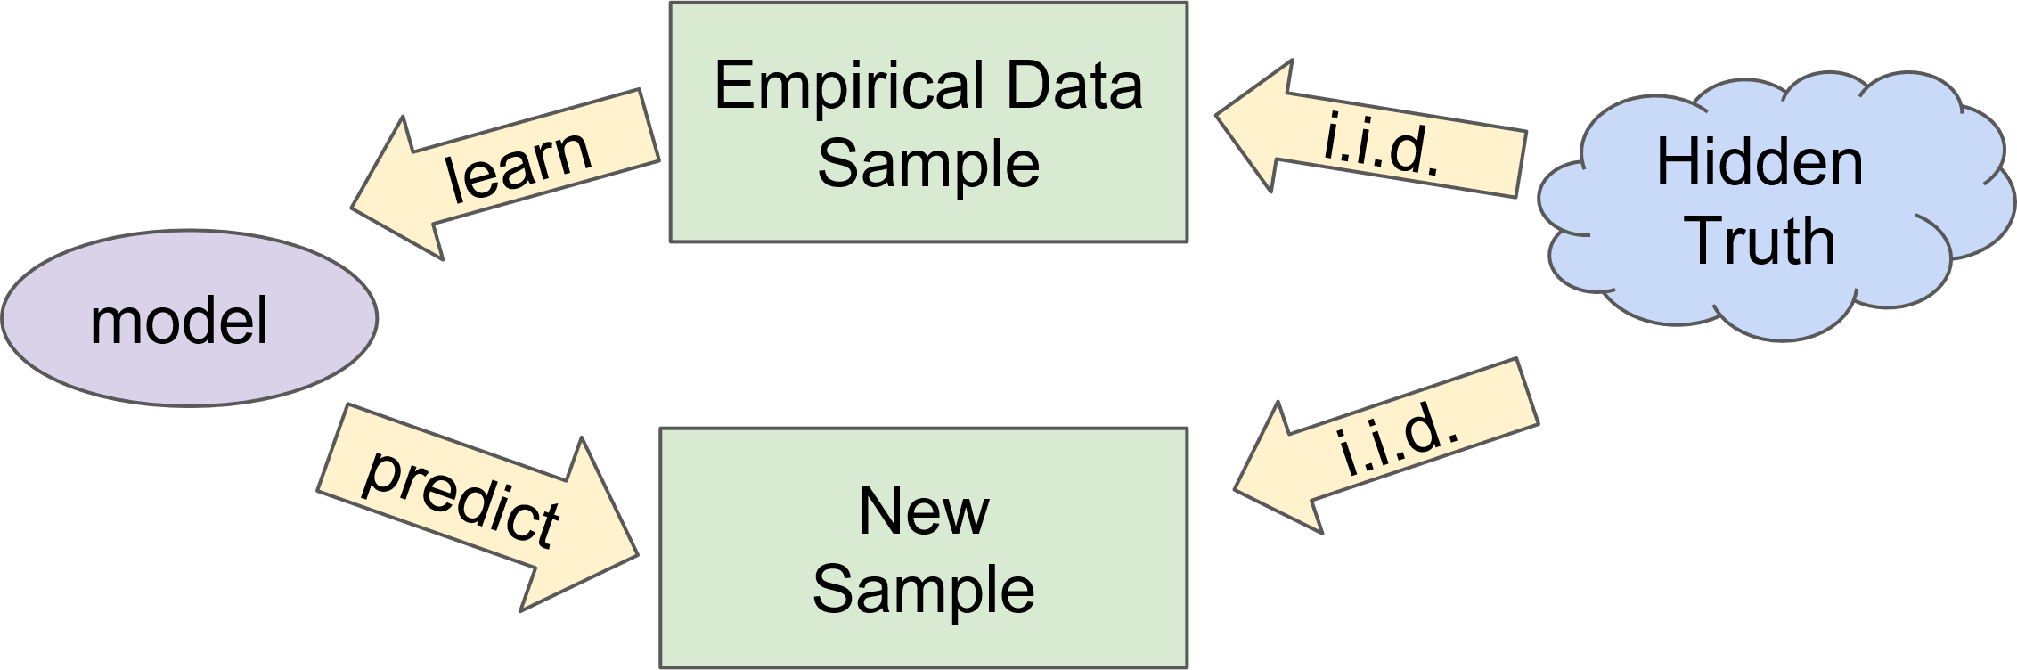
Backgrounds
Problems Faced by Traditional Machine Learning
Manual feature extraction & filtering
Features with high generalizability
Model generalization limitations
01
02
03
Time-consuming & labour-intensive
Is it suitable for various working conditions?
How about the models?
Notes:
649ad2db-8d3a-4973-ad22-0852ce57e02e.source.default.zh-Hans

Slide 15
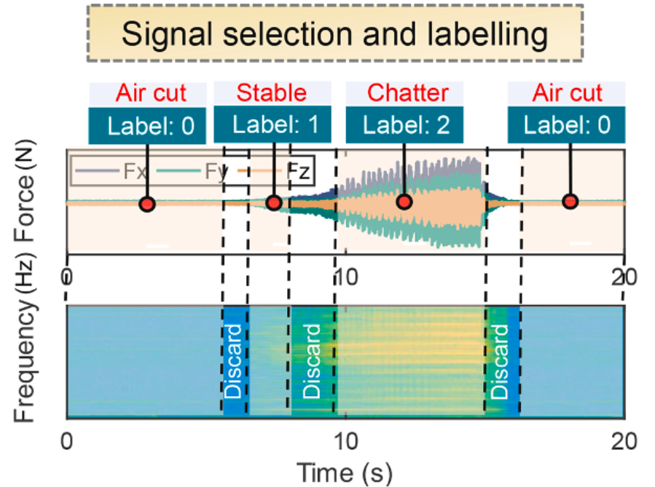
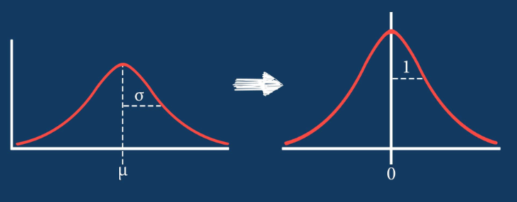
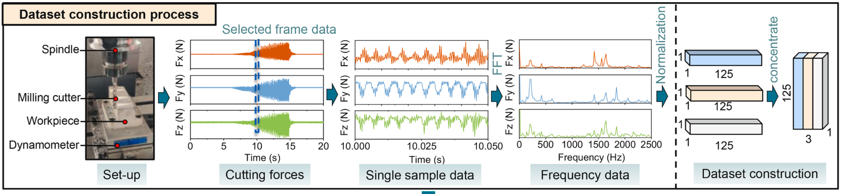
Data pre-procession
Labeling
Uses a data size of 250 per frame,
which corresponds to a sampling time of 0.05 s.
Fast Fourier Transform(FFT)
& Z-score Normalization
Size of 1*125*3
0 : Air cut 1 : Stable 2 : Chatter
Discard transition states

Slide 16
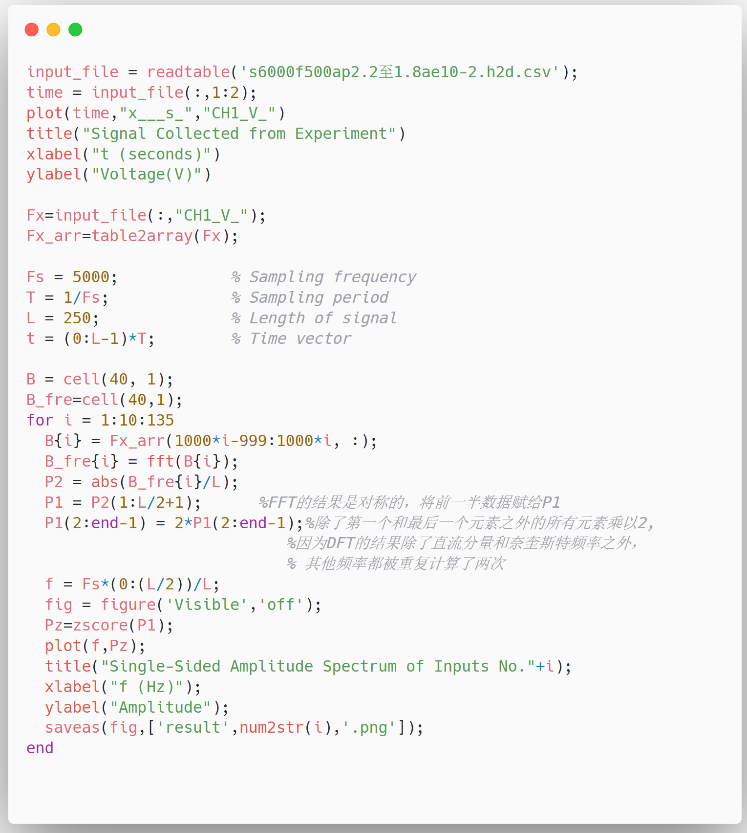
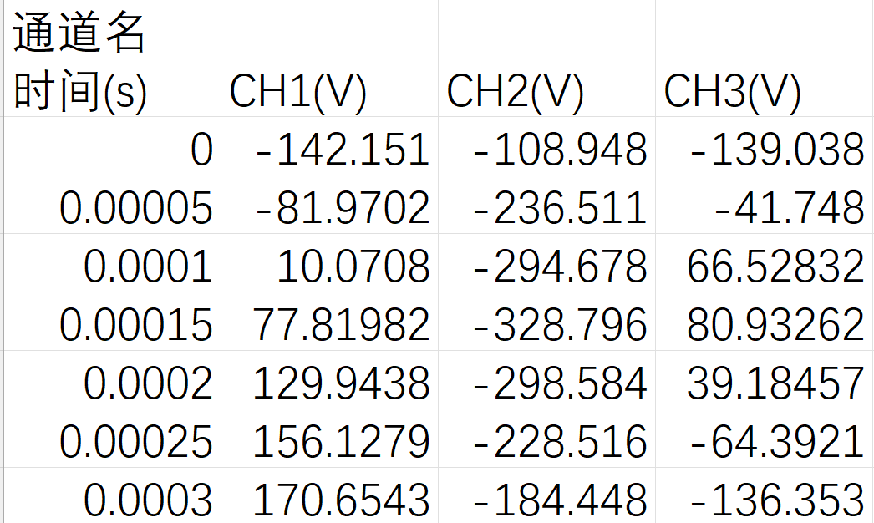
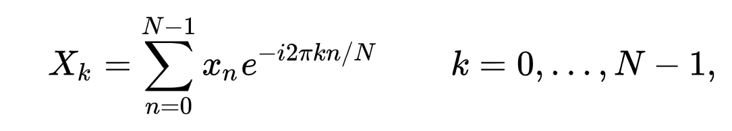
Data pre-procession（MATLAB）
Original data
FFT
Algorithm | Time Complexity
DFT | O(N²)
FFT | O(N logN)

Slide 17
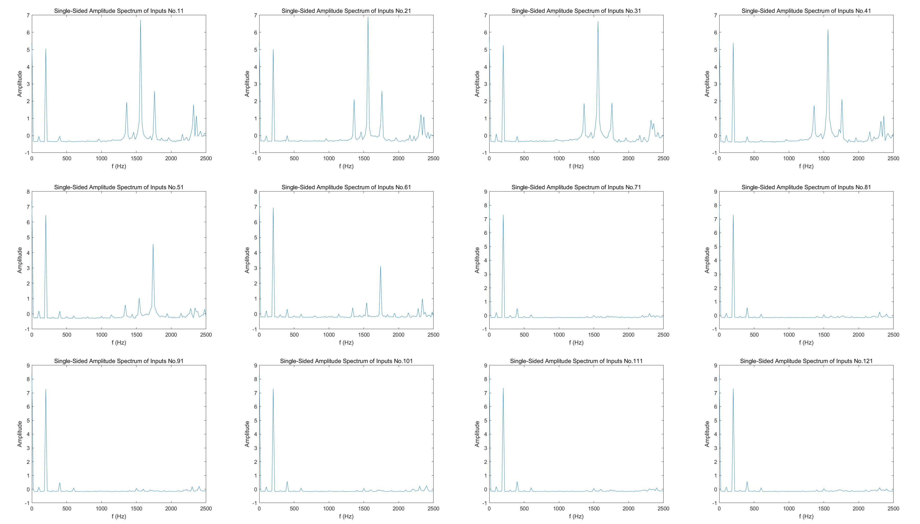
Data pre-procession

Slide 18
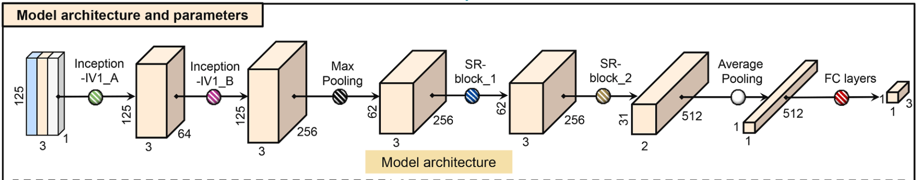
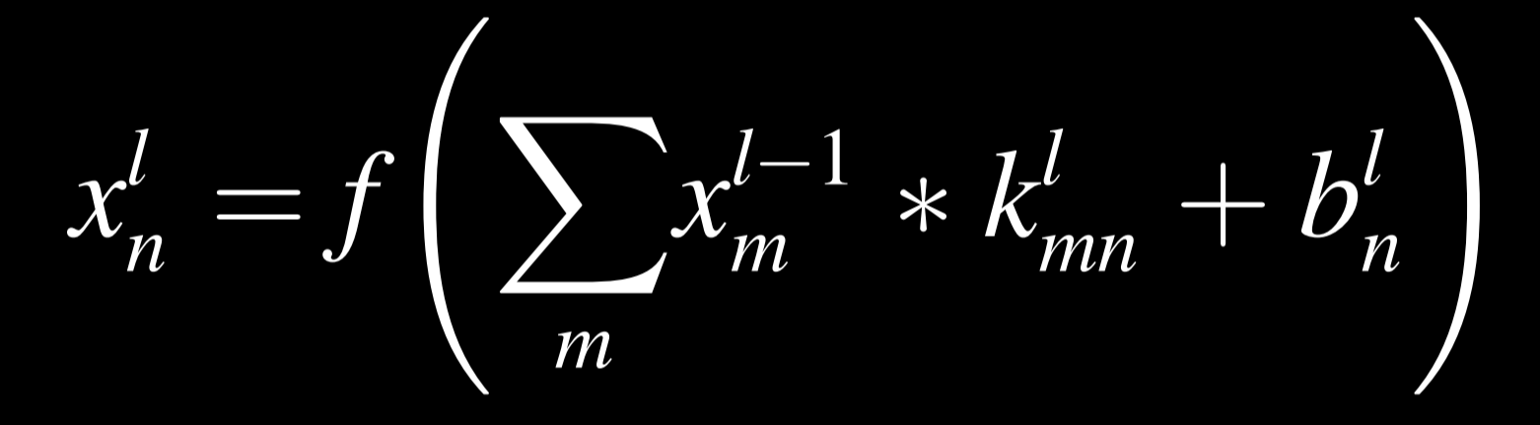
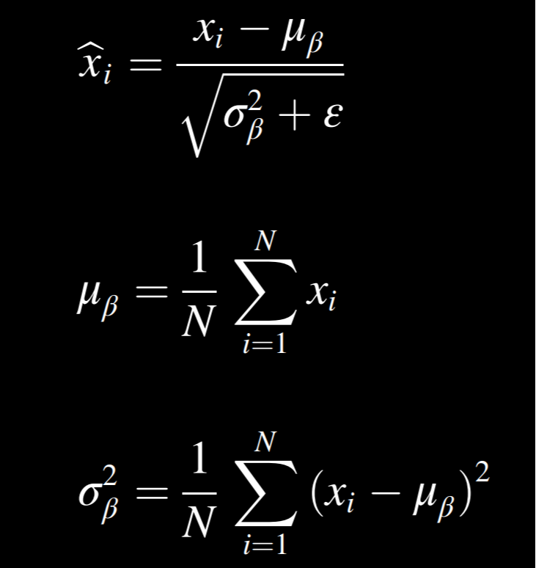
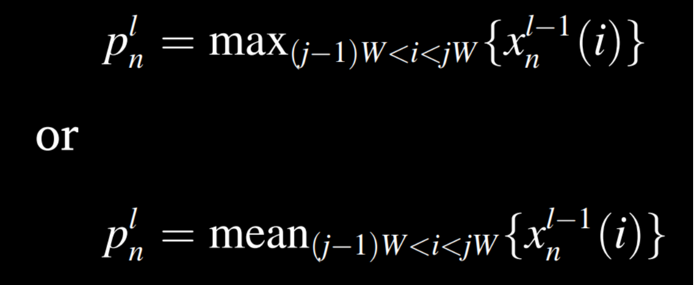
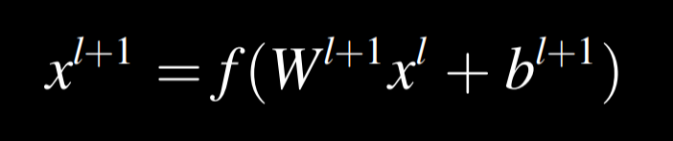
Model construction
Basic layers：
Batch normalization layer :
Convolution layer :
Pooling layer :
Fully connected layer :

Slide 19
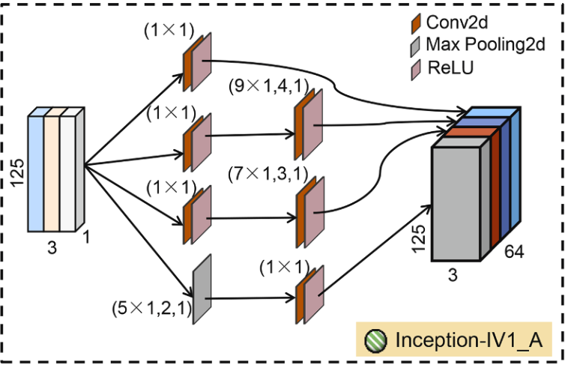
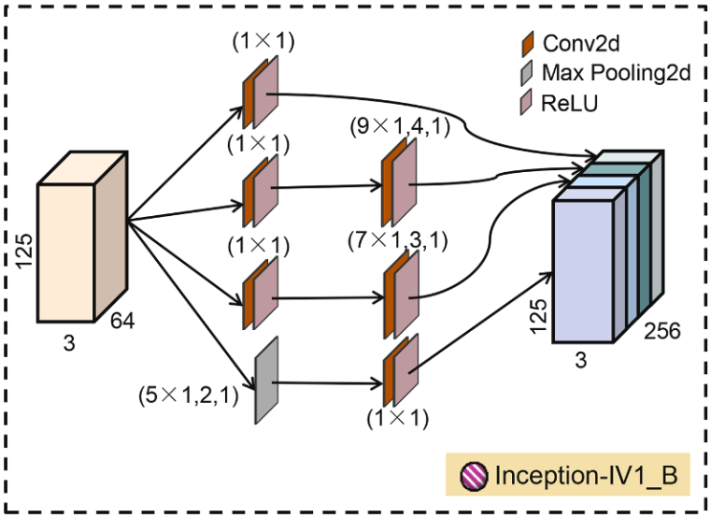
Inception Model
125*3*1 125*3*64
Cutting force :
one-dimensional
1 × 1 convolution kernel :
Reducing the computational complexity
Generalization and accuracy of chatter detection
C. Szegedy et al., "Going deeper with convolutions," 2015 IEEE Conference on Computer Vision and Pattern Recognition (CVPR), Boston, MA, USA, 2015, pp. 1-9, doi: 10.1109/CVPR.2015.7298594.

Slide 20
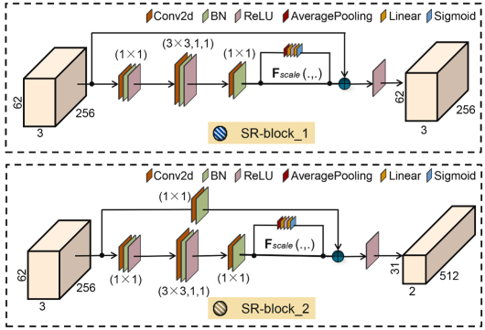
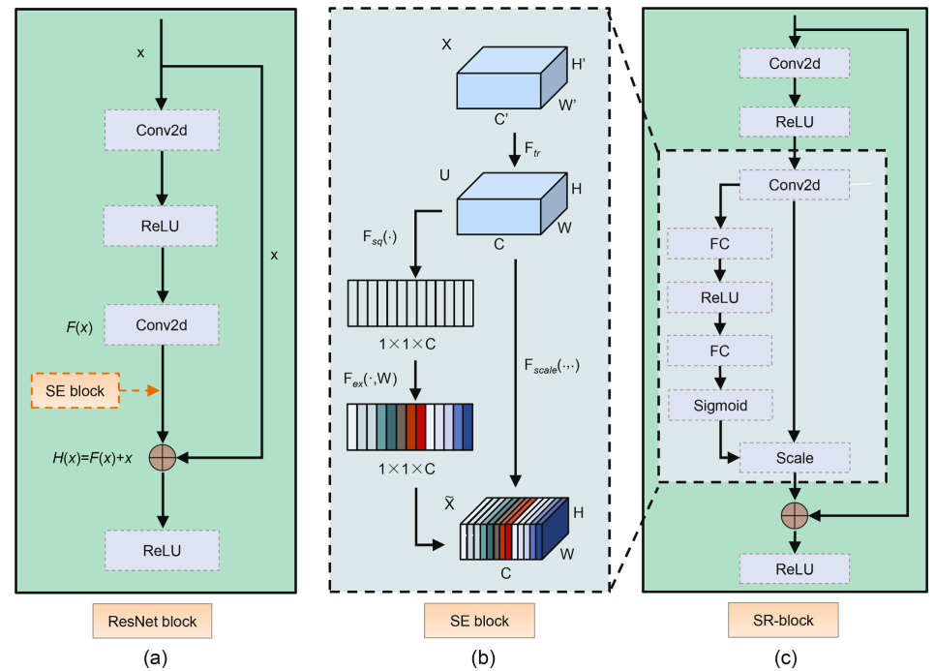
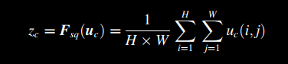
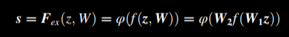
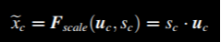
SR-block(SE block + ResNet)
125*3*64 31*2*512
ResNet
Squeeze-and-Excitation network
(SE-block)

Slide 21
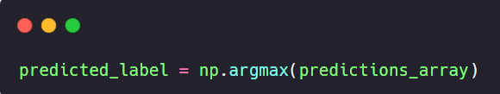
Classification
Labels
Predictions_array
(for example)
Air Cut(0)
0.01
Stable(1)
0.02
Chatter(2)
0.97
Confirm category : Chatter

Slide 22
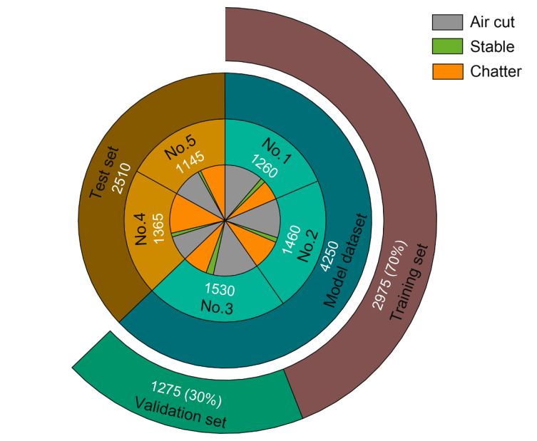
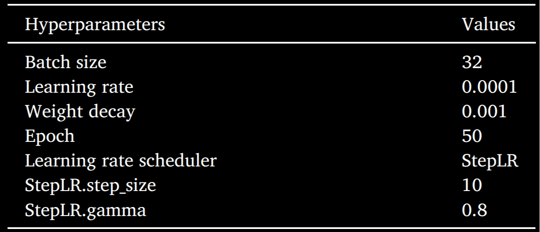
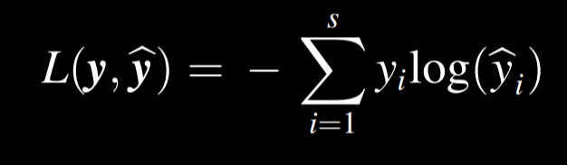
Training
Data composition
Training hyperparameters
Loss function : Cross-entropy Loss
Class | Subclass | Size
Model dataset | Training set | 2975
 | Validation set | 1275
Test set |  | 2510
Datas : from different spindle speed/depth of cut/width of cut/overhang length

Slide 23
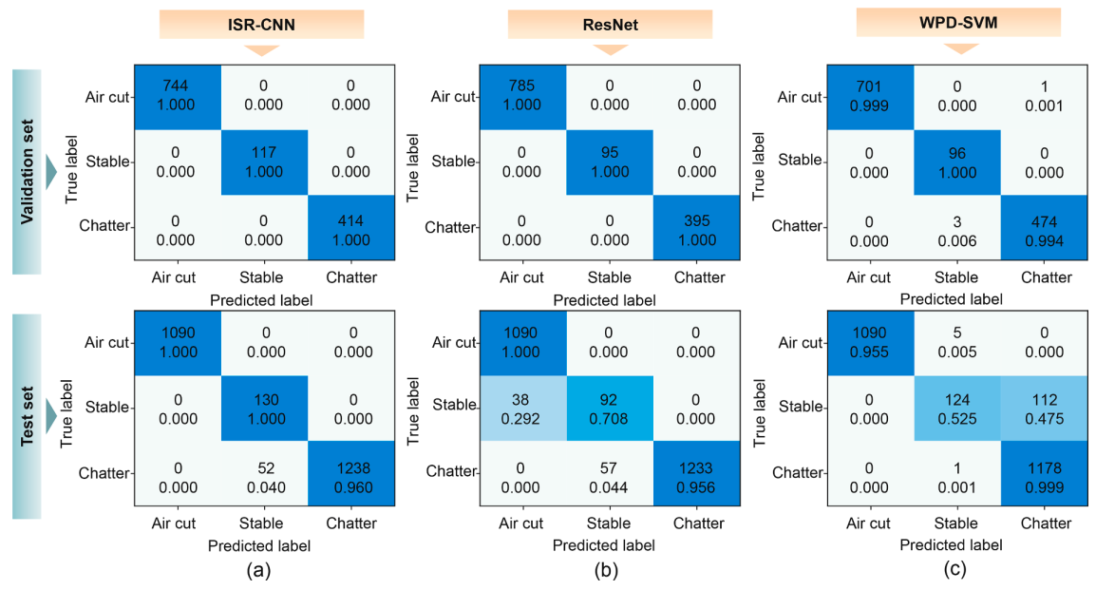
Training results
Confsion matrics of different model on validation and test set
Deep residual network(ResNet) : a popular method in chatter detection
Wavelet packet decomposition(WPD-SVM) : contain transition states
Z. Zhang, H. Li, G. Meng, X. Tu, C. Cheng, Chatter detection in milling process based on the energy entropy of VMD and WPD, Int. J. Mach. Tools Manuf. 108(2016) 106–112, https://doi.org/10.1016/j.ijmachtools.2016.06.002

Slide 24
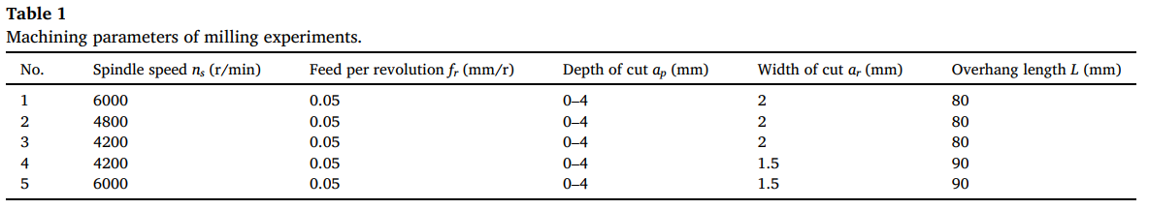
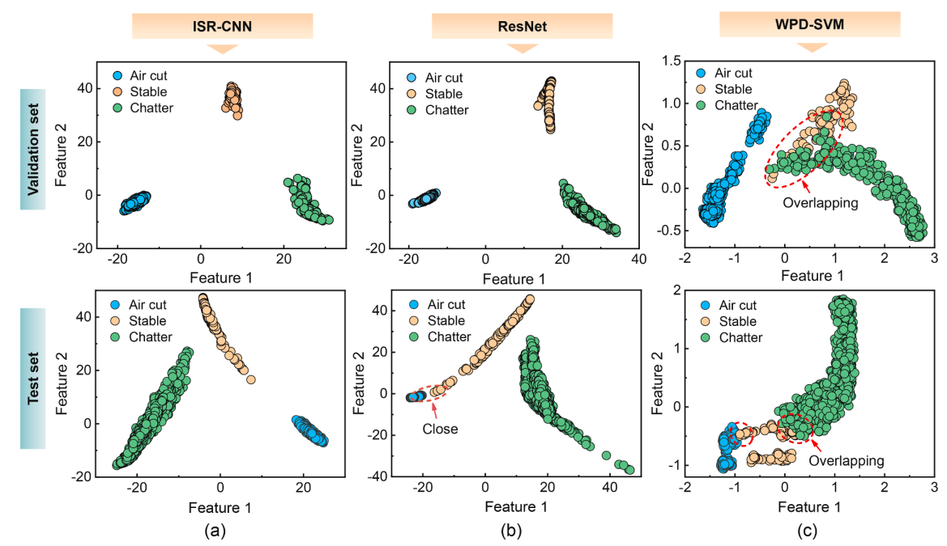
Q1：The classification accuracy of each model in the test set is less than that in the validation set？
The same machining parameters
Q2：Why the ISR-CNN model can better complete the classification task？
Principal Component Analysis (PCA) Data : Last FC-layer of the network
Close(ResNet)
Overlapping(WPD-SVM)

Slide 25
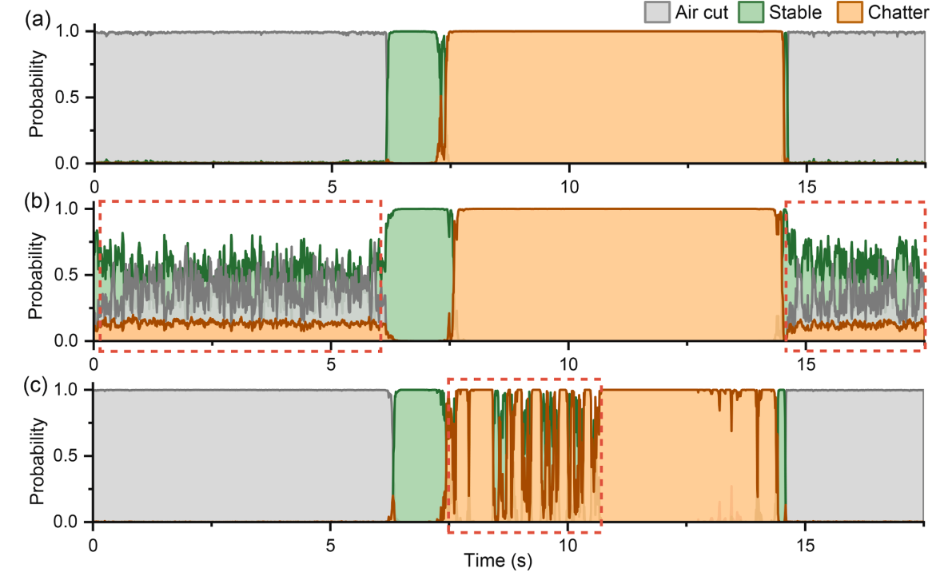
Whole process monitoring
(Contain transition states)
Poor generalization capability
Time delay
ISR-CNN
Fluctuate probability
in Air cut states
ResNet
Hard to distinguish Chatter states
WPD-SVM
7.2s
Chatter onset
14.5s
Chatter end

Slide 26


Summary
High accuracy
Validation set : 100%
Test set : 97.9%
Deep learning
with its outstanding
feature self-learning
and
classification capabilities
Non-overlap clusters
Do better in distinguishing different states.
Earlier detection
Model delay in the
millisecond range.
Excellent generalization
Better than traditional ML
and thresholding methods.

Slide 27


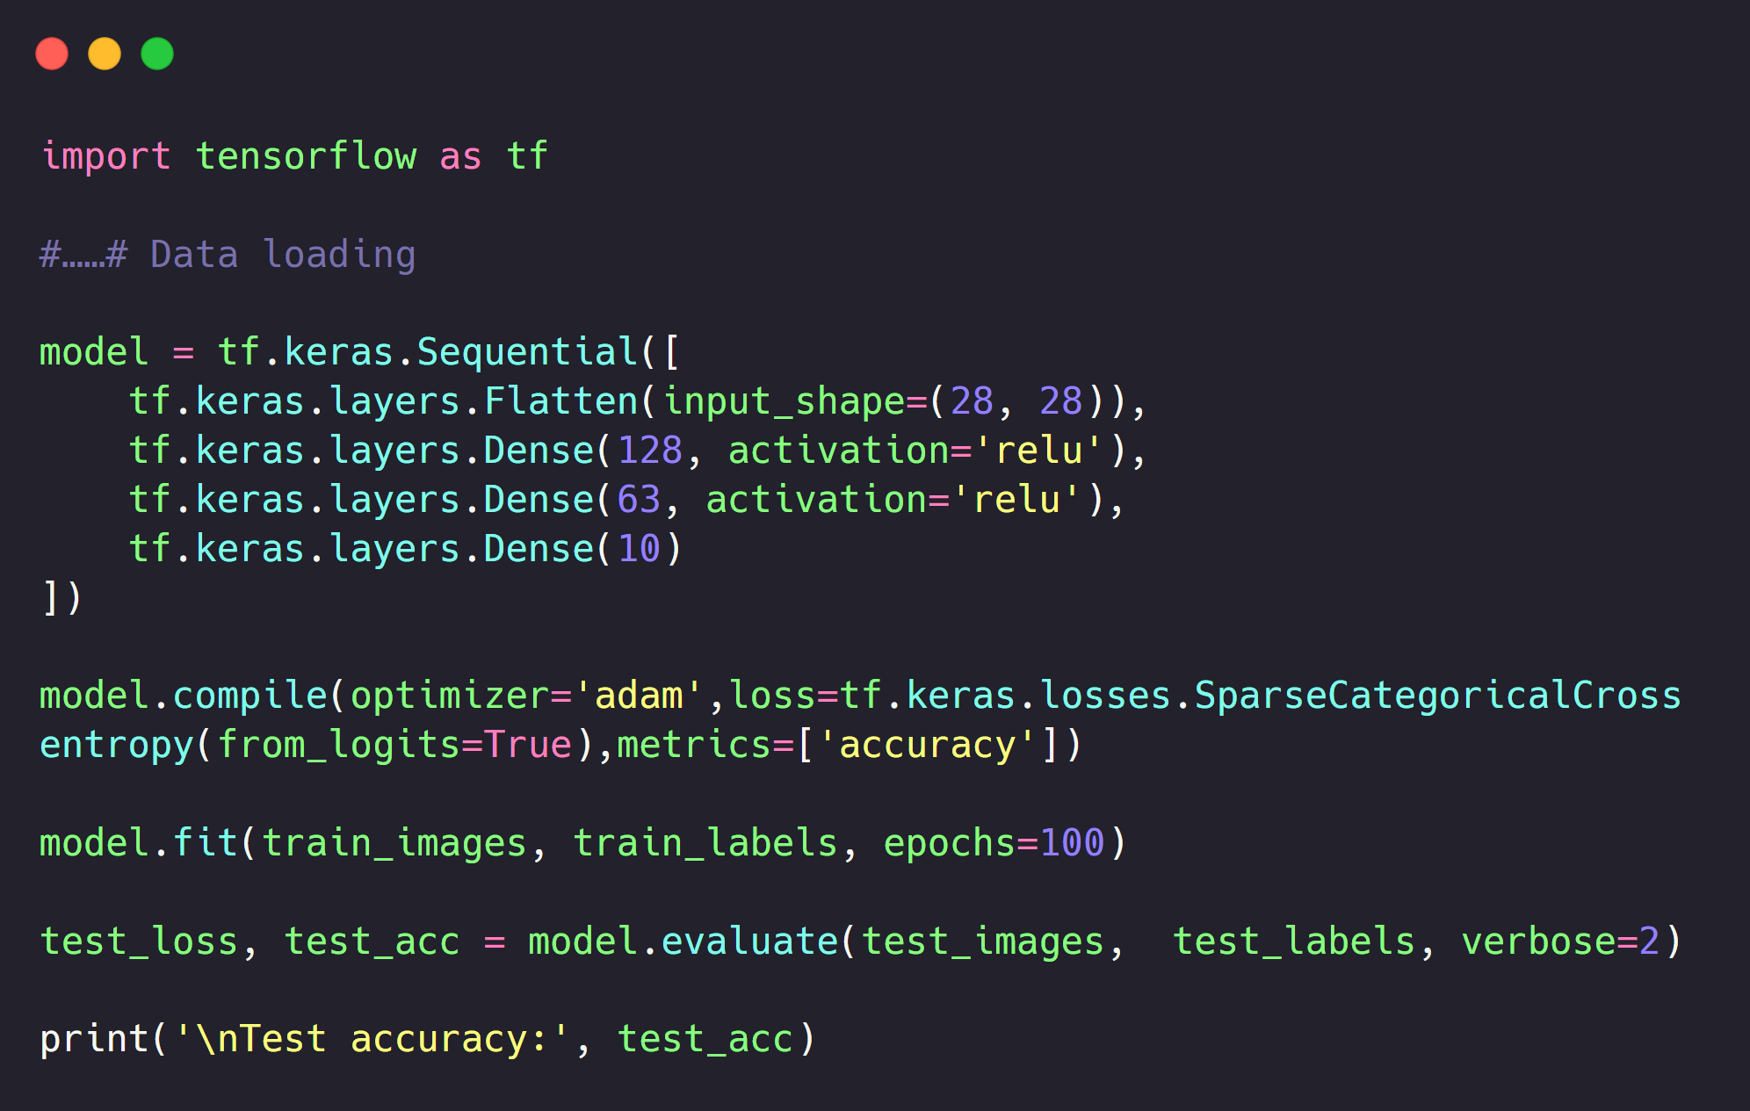
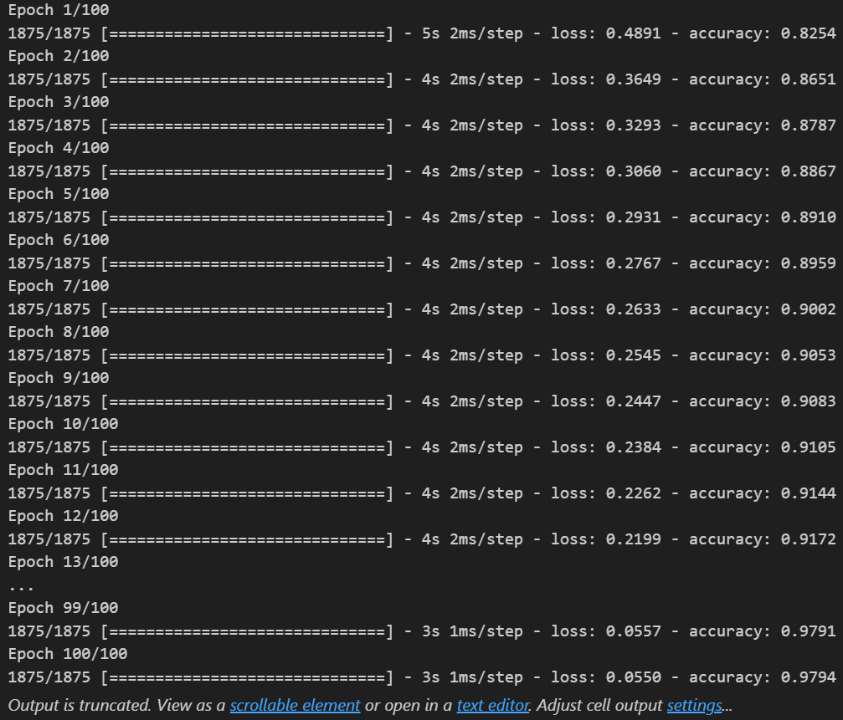

DL practice
Full-connected layers
Data sets | Size
Fashion-MNIST | (60000,28,28)

Slide 28






DL practice
convolutional neural networks
CPU
11th Gen
Intel® Core™
Processor
GPU
Tesla
T4 GPU

Slide 29


Comparison
Full-connected layers
convolutional neural networks

Slide 30
总结
学习内容：
阅读论文
学习相关算法及实现
见过实验室，和学长做了基本交流，了解基本情况
不足：
多理论而轻实践，本学期要多实践，多进实验室
扎实数学功底，继续努力学习相关知识
新知：
机械加工基础参数知识
震颤稳定性判断
部分机器学习算法及方法
部分深度学习算法及方法
Python、MATLAB基础
未至之境：
特征提取转换方法
模型搭建的过程
更多机械原理
算法优化

Slide 31

赵四维
2023.9.11
PRP43
基于深度学习的机器人加工 颤振在线辨识与智能抑振研究

